Slide 1
Java / J2EE Performance Analysis
Parameswari Ettiappan

Slide 2
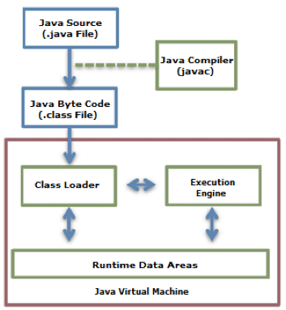
Java Code Execution Process.

Slide 3
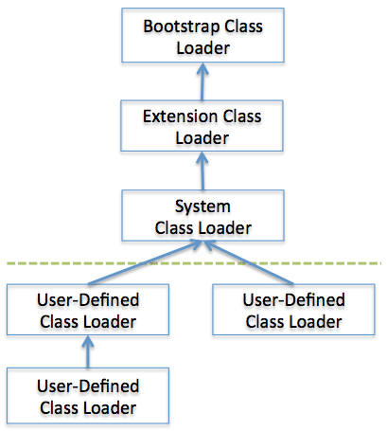
Class Loader
Bootstrap Class Loader Bootstrap class loader loads java’s core classes like java.lang, java.util etc. These are classes that are part of java runtime environment. Bootstrap class loader is native implementation and so they may differ across different JVMs.
Extensions Class Loader JAVA_HOME/jre/lib/ext contains jar packages that are extensions of standard core java classes. Extensions class loader loads classes from this ext folder. Using the system environment propery java.ext.dirs you can add ‘ext’ folders and jar files to be loaded using extensions class loader.
System Class Loader Java classes that are available in the java classpath are loaded using System class loader.

Slide 4
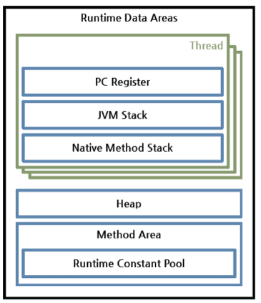
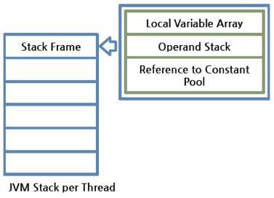
Runtime Data Areas

Slide 5
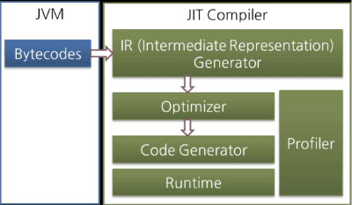
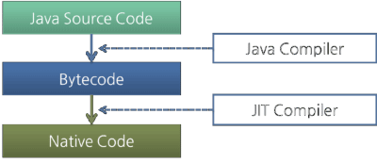
Byte Code to Machine Code
Interpreter
JIT

Slide 6
Hotspot VM
Oracle Hotspot VM uses a JIT compiler called Hotspot Compiler.
It is called Hotspot because Hotspot Compiler searches the 'Hotspot' that requires compiling with the highest priority through profiling, and then it compiles the hotspot to native code.
If the method that has the bytecode compiled is no longer frequently invoked, in other words, if the method is not the hotspot any more, the Hotspot VM removes the native code from the cache and runs in interpreter mode.
The Hotspot VM is divided into the Server VM and the Client VM, and the two VMs use different JIT compilers.

Slide 7
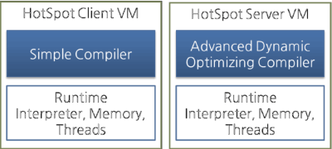
Hotspot VM

Slide 8
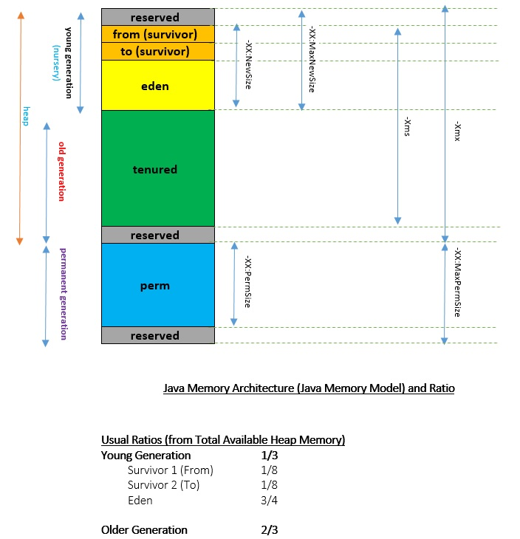

Slide 9
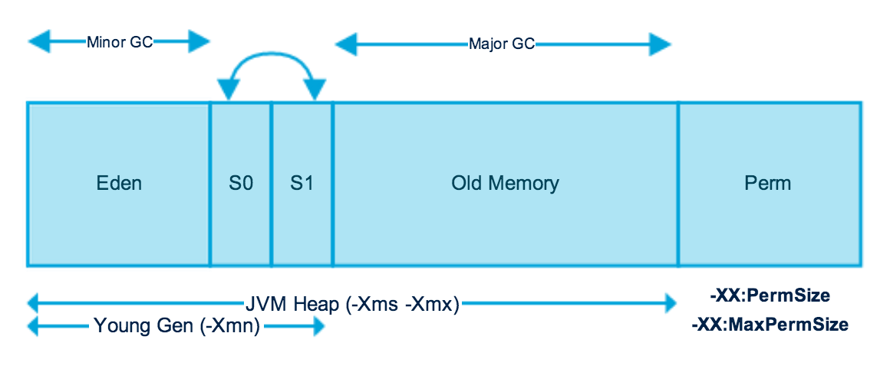
Java (JVM) Memory Model

Slide 10
Young Generation
Young generation is the place where all the new objects are created.
When young generation is filled, garbage collection is performed.
This garbage collection is called Minor GC.
Young Generation is divided into three parts
Eden Memory and two Survivor Memory spaces.

Slide 11
Young Generation
Most of the newly created objects are located in the Eden memory space.
When Eden space is filled with objects, Minor GC is performed and all the survivor objects are moved to one of the survivor spaces.
Minor GC also checks the survivor objects and move them to the other survivor space. So at a time, one of the survivor space is always empty.
Objects that are survived after many cycles of GC, are moved to the Old generation memory space. Usually it’s done by setting a threshold for the age of the young generation objects before they become eligible to promote to Old generation.

Slide 12
Old Generation
Old Generation memory contains the objects that are long lived and survived after many rounds of Minor GC.
Usually garbage collection is performed in Old Generation memory when it’s full.
Old Generation Garbage Collection is called Major GC and usually takes longer time.

Slide 13
Stop the World Event
All the Garbage Collections are “Stop the World” events because all application threads are stopped until the operation completes.
Since Young generation keeps short-lived objects, Minor GC is very fast and the application doesn’t get affected by this.
Major GC takes longer time because it checks all the live objects. Major GC should be minimized because it will make your application unresponsive for the garbage collection duration.
So responsive application and there are a lot of Major Garbage Collection happening leads to timeout errors.
The duration taken by garbage collector depends on the strategy used for garbage collection.
That’s why it’s necessary to monitor and tune the garbage collector to avoid timeouts in the highly responsive applications.

Slide 14
Permanent Generation
Permanent Generation or “Perm Gen” contains the application metadata required by the JVM to describe the classes and methods used in the application.
Note that Perm Gen is not part of Java Heap memory.
Perm Gen is populated by JVM at runtime based on the classes used by the application.
Perm Gen also contains Java SE library classes and methods.
Perm Gen objects are garbage collected in a full garbage collection.

Slide 15
Permanent Generation
Method Area
Method Area is part of space in the Perm Gen and used to store class structure (runtime constants and static variables) and code for methods and constructors.
Memory Pool
Memory Pools are created by JVM memory managers to create a pool of immutable objects, if implementation supports it.
String Pool is a good example of this kind of memory pool. Memory Pool can belong to Heap or Perm Gen, depending on the JVM memory manager implementation.

Slide 16
Permanent Generation
Runtime Constant Pool
Runtime constant pool is per-class runtime representation of constant pool in a class. It contains class runtime constants and static methods. Runtime constant pool is the part of method area.

Slide 17
Java Heap Memory Switches
VM Switch | VM Switch Description
-Xms | For setting the initial heap size when JVM starts
-Xmx | For setting the maximum heap size.
-Xmn | For setting the size of the Young Generation, rest of the space goes for Old Generation.
-XX:PermGen | For setting the initial size of the Permanent Generation memory
-XX:MaxPermGen | For setting the maximum size of Perm Gen
-XX:SurvivorRatio | For providing ratio of Eden space and Survivor Space, for example if Young Generation size is 10m and VM switch is -XX:SurvivorRatio=2 then 5m will be reserved for Eden Space and 2.5m each for both the Survivor spaces. The default value is 8.
-XX:NewRatio | For providing ratio of old/new generation sizes. The default value is 2.

Slide 18
Java Garbage Collection
Java Garbage Collection is the process to identify and remove the unused objects from the memory and free space to be allocated to objects created in the future processing.
One of the best feature of java programming language is the automatic garbage collection, unlike other programming languages such as C where memory allocation and deallocation is a manual process.

Slide 19
Java Garbage Collection
Garbage Collector
Program running in the background that looks into all the objects in the memory and find out objects that are not referenced by any part of the program.
All these unreferenced objects are deleted and space is reclaimed for allocation to other objects.

Slide 20
Java Garbage Collection
One of the basic way of garbage collection involves three steps:
Marking: This is the first step where garbage collector identifies which objects are in use and which ones are not in use.
Normal Deletion: Garbage Collector removes the unused objects and reclaim the free space to be allocated to other objects.
Deletion with Compacting: For better performance, after deleting unused objects, all the survived objects can be moved to be together. This will increase the performance of allocation of memory to newer objects.`

Slide 21
Java Garbage Collection
There are two problems with simple mark and delete approach.
First one is that it’s not efficient because most of the newly created objects will become unused
Secondly objects that are in-use for multiple garbage collection cycle are most likely to be in-use for future cycles too.

Slide 22
Java Garbage Collection Types
Serial GC (-XX:+UseSerialGC):
Serial GC uses the simple mark-sweep-compact approach for young and old generations garbage collection i.e Minor and Major GC.
Serial GC is useful in client-machines such as our simple stand alone applications and machines with smaller CPU.
It is good for small applications with low memory footprint.

Slide 23
Java Garbage Collection Types
Parallel GC (-XX:+UseParallelGC):
Parallel GC is same as Serial GC except that is spawns N threads for young generation garbage collection where N is the number of CPU cores in the system.
We can control the number of threads using -XX:ParallelGCThreads=n JVM option.
Parallel Garbage Collector is also called throughput collector because it uses multiple CPUs to speed up the GC performance.
Parallel GC uses single thread for Old Generation garbage collection.

Slide 24
Java Garbage Collection Types
Parallel Old GC (-XX:+UseParallelOldGC):
This is same as Parallel GC except that it uses multiple threads for both Young Generation and Old Generation garbage collection.

Slide 25
Java Garbage Collection Types
Concurrent Mark Sweep (CMS) Collector (-XX:+UseConcMarkSweepGC):
CMS Collector is also referred as concurrent low pause collector.
It does the garbage collection for Old generation.
CMS collector tries to minimize the pauses due to garbage collection by doing most of the garbage collection work concurrently with the application threads.
CMS collector on young generation uses the same algorithm as that of the parallel collector.
This garbage collector is suitable for responsive applications where we can’t afford longer pause times.
We can limit the number of threads in CMS collector using -XX:ParallelCMSThreads=n JVM option.

Slide 26
Java Garbage Collection Types
G1 Garbage Collector (-XX:+UseG1GC):
The Garbage First or G1 garbage collector is available from Java 7 and it’s long term goal is to replace the CMS collector.
The G1 collector is a parallel, concurrent, and incrementally compacting low-pause garbage collector.Garbage
First Collector doesn’t work like other collectors and there is no concept of Young and Old generation space.
It divides the heap space into multiple equal-sized heap regions.
When a garbage collection is invoked, it first collects the region with lesser live data, hence “Garbage First”.

Slide 27
Determining the Default Compiler
java –version
java -client –version
What if no compiler argument is given at all?
Then the JVM uses the default compiler for the machine on which the code is running: the default compiler is a runtime choice.
This choice is made based on whether the JVM considers the machine to be a “client” machine or a “server” machine.
That decision is based on a combination of the operating system and number of CPUs on the machine

Slide 28
Java Garbage Collection Monitoring
java -Xmx120m -Xms30m -Xmn10m -XX:PermSize=20m -XX:MaxPermSize=20m -XX:+UseSerialGC -jar Java2Demo.jar

Slide 29
Recommended JVM options.
Type | Option
Operation mode | -sever
Entire heap size | Specify the same value for -Xms and -Xmx.
New area size | -XX:NewRatio: value of 2 to 4
 | -XX:NewSize=? –XX:MaxNewSize=?. Also good to specify NewSize instead of NewRatio.
Perm size | -XX:PermSize=256 m -XX:MaxPermSize=256 m. Specify the value to an extent not to cause any trouble in the operation because it does not affect the performance.
GC log | -Xloggc:$CATALINA_BASE/logs/gc.log -XX:+PrintGCDetails -XX:+PrintGCDateStamps. Leaving a GC log does not particularly affect the performance of Java applications. You are recommended to leave a GC log as much as possible.
GC algorithm | -XX:+UseParNewGC -XX:+CMSParallelRemarkEnabled -XX:+UseConcMarkSweepGC-XX:CMSInitiatingOccupancyFraction=75.This is only a generally recommendable configuration. Other choices could be better depending on the characteristics of the application.
Creating a heap dump when an OOM error occurs | -XX:+HeapDumpOnOutOfMemoryError -XX:HeapDumpPath=$CATALINA_BASE/logs
Actions after an OOM occurs | -XX:OnOutOfMemoryError=$CATALINA_HOME/bin/stop.sh or -XX:OnOutOfMemoryError=$CATALINA_HOME/bin/restart.sh. After leaving a heap dump, take a proper o

Slide 30
The IDE monitoring tools
Most of the Java IDEs either include a tool to profile the Java application or support the plugin installation of similar tools. For example, we can download Eclipse plugins, such as the TPTP, JVM monitor, and Memory Analyzer.
Some third-party utilities that run as standalone tools can also integrate with different IDEs.
For example, JProfiler can integrate with different versions of NetBeans, JDeveloper, Eclipse, and IntelliJ IDEA

Slide 31
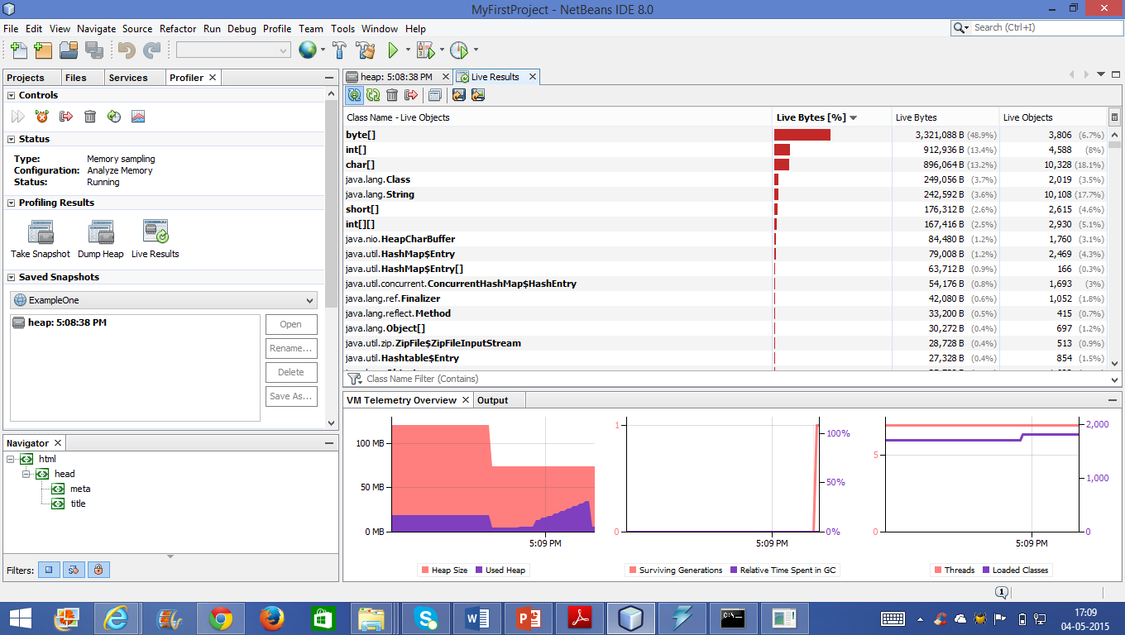
The IDE monitoring tools

Slide 32
The standalone monitoring tools
The standalone monitoring tools include a lot of third-party utilities.
Some examples of these tools are AppDynamics, JBossProfiler, JProbe and JProfiler, and so on.

Slide 33
The multifunction monitoring tools
The multifunction monitoring tools are configurable tools that can monitor the
environment, application server, different resources, virtual machine, and so on via
different available matrices.
They also send different alerts, and the best examples for these tools are Intel
Foglight, Hyperic HQ, HP SiteScope, and so on.

Slide 34
Tuning Java heap for performance
Maximum possible Java heap sizes
The “correct” Java heap size
Fixed heap sizes vs. Variable heap sizes
Heap Sizing for Generational GC
32 bit Java processes have maximum possible heap size
32 bit architecture has addressable space of 2^32
Which is 4GigaBytes
Determined by the process memory layout
64 bit processes do not have this limit
Limit exists, but is so large it can be effectively ignored
Addressability usually between 2^44 and 2^64
Which is 16+ TeraBytes

Slide 35
Default compiler based on OS and machine

Slide 36
Tuning the Code Cache
When the JVM compiles code, it holds the set of assembly-language instructions in the code cache.
The code cache has a fixed size, and once it has filled up, the JVM is not able to compile any additional code.
If the code cache is too small, some hot spots will get compiled, but others will not: the application will end up running a lot of (very slow) interpreted code.
-XX:InitialCodeCacheSize=N // initial code cache value
-XX:ReservedCodeCacheSize=N //maximum size of code cache value
(on Intel machines, the client compiler starts with a 160 KB cache and the server compiler starts with a 2,496 KB cache)

Slide 37
Default code cache based on platform

Slide 38
Performance Analysis of Java Application
The goal of performance analysis in JAVA application is to determine which parts of a program require optimization to increase its execution speed or lower its memory usage.
Primarily used for…
–pro-active bottleneck identification .
"fixing" Scenarios that are not meeting requirements/SLAs

Slide 39
Tuning Java heap for performance
Maximum possible Java heap sizes
The “correct” Java heap size
Fixed heap sizes vs. Variable heap sizes
Heap Sizing for Generational GC
32 bit Java processes have maximum possible heap size
32 bit architecture has addressable space of 2^32
Which is 4GigaBytes
Determined by the process memory layout
64 bit processes do not have this limit
Limit exists, but is so large it can be effectively ignored
Addressability usually between 2^44 and 2^64
Which is 16+ TeraBytes

Slide 40
Theoretical and Advised Max Heap Sizes

Slide 41
Trade-off: Heap Size vs. Performance

Slide 42
Fixed heap sizes vs. Variable heap sizes

Slide 43
Different GC options
Survivor spaces swap rules now;
the From survivor space now becomes empty and will be the To survivor space.
the To survivor space becomes full and will be the From survivor space in the next cycle

Slide 44
Different GC options

Slide 45
Different GC options
The HotSpot JVM also includes the CMS collector, which is considered a low-latency
collector.
This collector differs mainly in the way it deals with the old generation space
collection.
It deals with the young generation in the same way as the parallel collector.

Slide 46
CMS
Mark step: This step includes the following three phases:
Initial mark phase: The collector initially marks all the reachable live objects (the first short pause time)
Concurrent mark phase: The concurrent marking of the objects follows perfectly, but because the application is running and updating reference fields while the marking phase is taking place, not all live objects are guaranteed to be marked at the end of this phase
Final remark phase: The application stops again for a second pause, and finalizes the marking by revisiting any objects that were modified during the concurrent marking phase
Sweep step (concurrent): The concurrent sweep phase reclaims all the garbage that has been identified.

Slide 47
CMS

Slide 48
The Garbage-first collector – G1
The G1 collector is a recently introduced garbage collector; it is supported since Oracle JDK 7 update 4.
The G1 collector is a server-style garbage collector targeted for multiprocessor
machines with large memories

Slide 49
System Limitations and What to Tune
Three resources limit all applications:
• CPU speed and availability
• System memory
• Disk (and network) input/output (I/O)
When tuning an application, the first step is to determine which of these is causing your application to run too slowly.

Slide 50
System Limitations and What to Tune
If your application is CPU -bound, you need to concentrate your efforts on the code,
looking for bottlenecks, inefficient algorithms, too many short-lived objects (object creation and garbage collection are CPU-intensive operations), and other problems.
If your application is hitting system-memory limits, it may be paging sections in and out of main memory.
In this case, the problem may be caused by too many objects, or even just a few large objects, being erroneously held in memory;
by too many large arrays being allocated (frequently used in buffered applications);
or by the design of the application, which may need to be re examined to reduce its running memory footprint.

Slide 51
System Limitations and What to Tune
On the other hand, external data access or writing to the disk can be slowing your application.
In this case, you need to look at exactly what you are doing to the disks that is slowing the application:
first identify the operations, then determine the problems, and finally eliminate or change these to improve the situation.

Slide 52
A Tuning Strategy
1. Measure the performance using profilers and benchmark suites, and by instrumenting code.
2. Identify the locations of any bottlenecks.
3. Think of a hypothesis for the cause of the bottleneck.
4. Consider any factors that may refute your hypothesis.
5. Create a test to isolate the factor identified by the hypothesis.
6. Test the hypothesis.
7. Alter the application to reduce the bottleneck.
8. Test that the alteration improves performance, and measure the improvement (include regression testing the affected code).
9. Repeat from Step 1.

Slide 53
What to Measure
CPU time (the time allocated on the CPU for a particular procedure)
The number of runnable processes waiting for the CPU (this gives you an idea of CPU contention)
Paging of processes
Memory sizes
Disk throughput
Disk scanning times
Network traffic, throughput, and latency
Transaction rates
Other system values

Slide 54
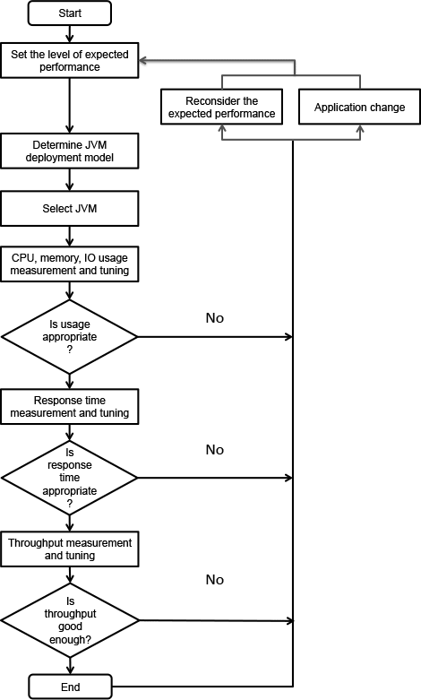
The Process of Java Application Performance Tuning

Slide 55
Dissecting performance testing
Assess the application’s performance and compare it to the agreed SLAs
Assess the application’s design and implementation quality
Assess the application’s capacity
Identify and fix any potential performance issues
Enhance the performance of the application
Get performance benchmark or baseline for subsequent releases

Slide 56
Dissecting performance testing
Warm Up Time
Cool Down Time

Slide 57
Performance testing types
Load testing
This type of testing tests the performance of the application under an anticipated
workload, by using a specific number of concurrent users with a specific number of
transactions.
One of the load testing variants is Soak/Endurance Testing.
This type of testing tests the performance of the application under a prolonged period of time (12 hours or more) to determine whether the application can withstand the continuous workload or not.

Slide 58
Performance testing types
Stress testing
This type of testing tests the performance of the application beyond the anticipated
workload. The main objective is to determine the upper limits of the application and its robustness.
One of its variants is to use spike load to test the application’s response with a sudden
increase in workload.
Capacity testing
This type of testing aims to test the maximum capacity of the application while the
application can still meet the performance goals (for example, handling the number of concurrent users).

Slide 59
Starting with Apache JMeter
It can be used to load and performance test many different server/protocol types, as
follows:
Web—HTTP and HTTPS
SOAP
FTP
Database via JDBC
LDAP
Message-Oriented Middleware (MOM) via JMS
Mail—SMTP(s), POP3(s), and IMAP(s)
Native commands or shell scripts
TCP

Slide 60
Monitoring Java Applications
The operating system monitoring tools
The Microsoft Windows tools

Slide 61
Monitoring Java Applications
The operating system monitoring tools
The Microsoft Windows tools

Slide 62
Monitoring Java Applications
The operating system monitoring tools
The Microsoft Windows tools
C:\>typeperf "\Processor(*)\% Processor Time" -o c:\results.csv

Slide 63
The Java monitoring tools
The JDK monitoring tools
The JDK monitoring tools include a lot of useful tools such as jconsole, jmap, jhat,
jstat, jvisualvm, and Oracle Java Mission Control (jmc).

Slide 64
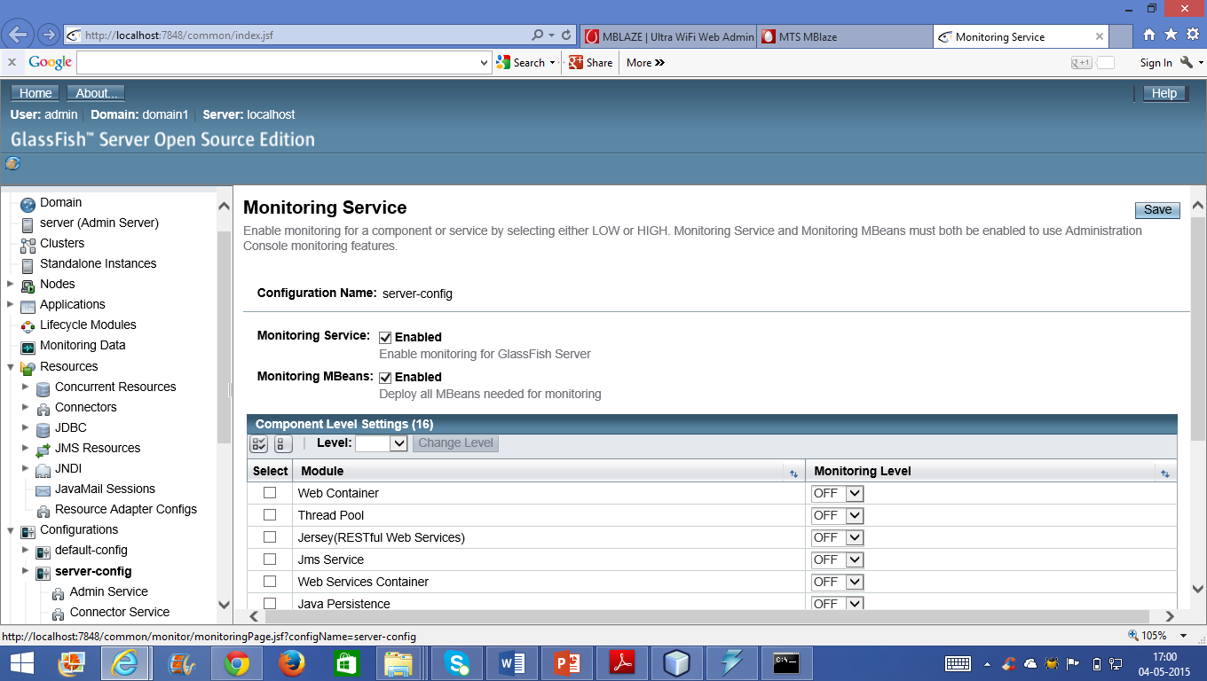
The Java monitoring tools

Slide 65
The IDE monitoring tools
Most of the Java IDEs either include a tool to profile the Java application or support the plugin installation of similar tools. For example, we can download Eclipse plugins, such as the TPTP, JVM monitor, and Memory Analyzer.
Some third-party utilities that run as standalone tools can also integrate with different IDEs.
For example, JProfiler can integrate with different versions of NetBeans, JDeveloper, Eclipse, and IntelliJ IDEA

Slide 66
The IDE monitoring tools

Slide 67
The standalone monitoring tools
The standalone monitoring tools include a lot of third-party utilities.
Some examples of these tools are AppDynamics, JBossProfiler, JProbe and JProfiler, and so on.

Slide 68
The multifunction monitoring tools
The multifunction monitoring tools are configurable tools that can monitor the
environment, application server, different resources, virtual machine, and so on via
different available matrices.
They also send different alerts, and the best examples for these tools are Intel
Foglight, Hyperic HQ, HP SiteScope, and so on.

Slide 69
Understanding the profiling tools
Profilers are the tools that allow us to get dynamic information and monitor our executing program.
The main difference between monitoring tools and profilers is the level of detail that can be provided.
Monitoring tools provide high-level information. On the other hand, profilers provide very low-level detail, so it can catch the HotSpot areas more efficiently and point to a single programming statement.
Also, the monitoring tools, as the name suggests, merely inspect the application’s performance, while profiling tools are usually much more advanced and can go the extra mile to instrument or probe the application.
So it can evaluate each part of the application and point to the underperforming areas, that is, the HotSpot areas.
All tools can be monitoring tools, but not all can be profiler tools.

Slide 70
Profilers modes
Profilers can work on many different strategies, such as event based, instrumental based and sampling (statistical) as follows:
Event based: In event based, the profiler captures the application’s events. The
events represent the methods’ calls, class loading, thread changes, and so on.
Instrumental based: This method instruments the application with additional
instructions to gather more information. This causes the highest impact on the
application’s execution time compared to the other types.
Sampling based (statistical): This method probes the target program’s counter at
regular intervals using operating system interrupts. Sampling profiles are less
accurate but give the nearest normal execution time of the target application.

Slide 71
Result of Tool

Slide 72
The monitoring tool for Java virtual machine statistics
The jstat tool is used to gather some statistics about the Java virtual machine, mainly
memory statistics, different spaces, loaded classes, garbage collections, and so on.
The general syntax of this tool is as follows:
jstat [ generalOption | outputOptions vmid [interval[s|ms] [count]] ]

Slide 73
The monitoring tool for Java virtual machine statistics

Slide 74
The monitoring tool for Java virtual machine statistics

Slide 75
The monitoring tool for Java virtual machine statistics
S0C and S1C: This column shows the current size of the Survivor0 and Survivor1 areas in KB.
S0U and S1U: This column shows the current usage of the Survivor0 and Survivor1 areas in KB. Notice that one of the survivor areas are empty all the time.
EC and EU: These columns show the current size and usage of Eden space in KB. Note that EU size is increasing and as soon as it crosses the EC, Minor GC is called and EU size is decreased.
OC and OU: These columns show the current size and current usage of Old generation in KB.
PC and PU: These columns show the current size and current usage of Perm Gen in KB.
YGC and YGCT: YGC column displays the number of GC event occurred in young generation. YGCT column displays the accumulated time for GC operations for Young generation. Notice that both of them are increased in the same row where EU value is dropped because of minor GC.
FGC and FGCT: FGC column displays the number of Full GC event occurred. FGCT column displays the accumulated time for Full GC operations. Notice that Full GC time is too high when compared to young generation GC timings.
GCT: This column displays the total accumulated time for GC operations. Notice that it’s sum of YGCT and FGCT column values.

Slide 76
The JVM memory map tool
The jmap tool is used to display memory information about any running Java process.
This can be also used to dump heap memory content. The usage of the tools with the syntax is given as follows:
The jmap tool will print all the shared object mappings. The syntax is as follows:
jmap [ option ] pid <no option>
The -dump parameter dumps the Java heap content in the hprof binary file format.
If the live suboption is specified, only the current live objects inside the heap are dumped.
The syntax is as follows:
-dump:[live,]format=b,file=<filename>

Slide 77
The JVM memory map tool
The -finalizerinfo parameter displays information about objects waiting on
finalization. The syntax is as follows:
-finalizerinfo
The -heap parameter shows the heap summary. The following is the syntax for an
algorithm used for GC, heap configuration, and heap generation usages:
-heap
The -histo parameter prints the heap histogram. For example, for each Java class,
the tool will print the number of instances, occupied memory in bytes, and qualified
class names. If the live suboption is specified, only the current live objects are
counted. The syntax is as follows:
-histo[:live]

Slide 78
The JVM memory map tool
The -permstat parameter prints the class loader statistics of the heap permanent
generation.
For example, for each class loader, the tool will print its name, liveness,
address, parent class loader, and number and size of classes it has loaded.
Also, the number and size of the interned strings are printed.
The syntax is as follows:
-permstat
The -J parameter is used to pass different flags to the JVM. The syntax is as follows:
-J<flag>

Slide 79
The JVM memory map tool
//jmap -heap 2296
jmap -dump:live,format=b,file=mydump 1668

Slide 80
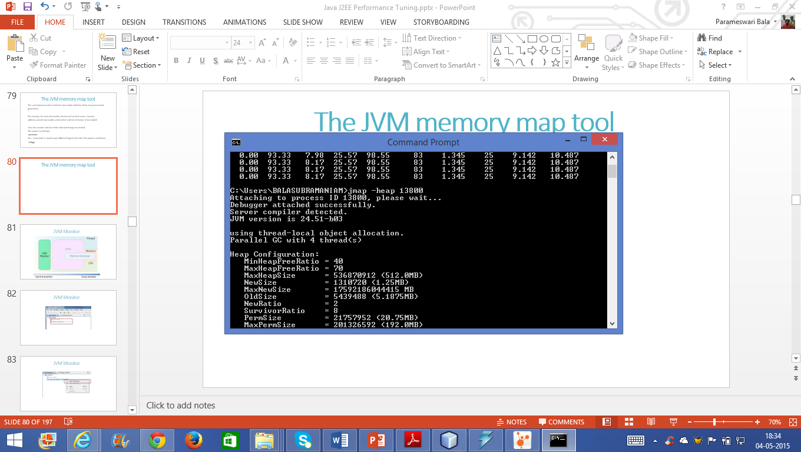
The JVM memory map tool

Slide 81
Memory Leak

Slide 82
Memory Leak

Slide 83
The Java heap analysis tool
The jhat tool is used to analyze the heap dumps. The syntax looks like the following
code:
jhat [ options ] <heap-dump-file>
jhat mydump
Now, open the following URL using your browser:
http://localhost:7000/

Slide 84
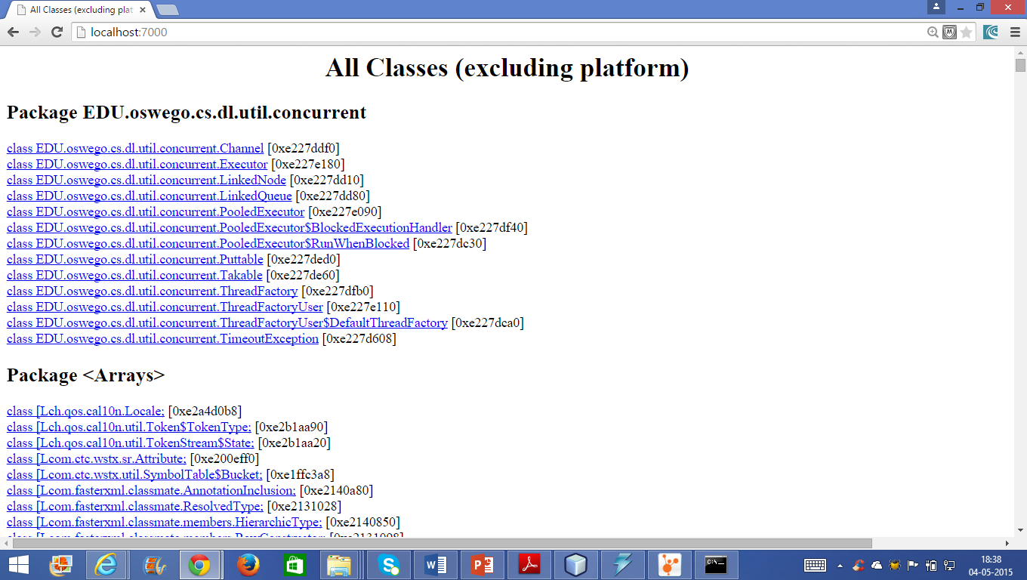
The Java heap analysis tool

Slide 85
The Java monitoring and management console tool
The jconsole tool is a good profiling tool with a graphical user interface that enables us to monitor and manage the Java applications and virtual machines on a local or remote host.
The command syntax looks as follows:
jconsole [ options ] [ connection… ]

Slide 86
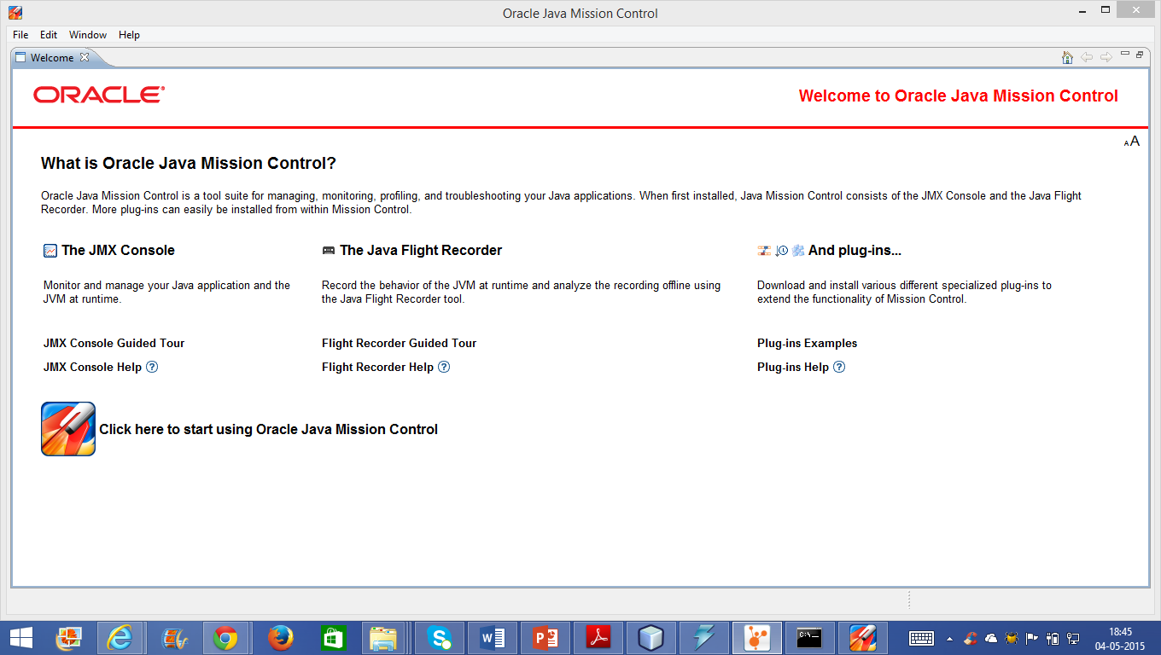
Oracle Java Mission Control

Slide 87
Oracle Java Mission Control
-XX:+UnlockCommercialFeatures -XX:+FlightRecorder -
XX:StartFlightRecording=duration=30s,filename=d:/recording.jfr

Slide 88
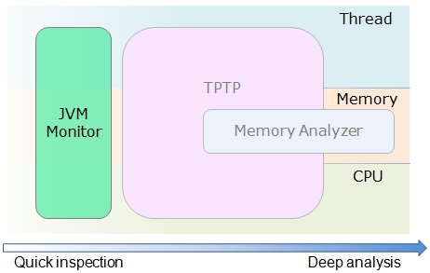
JVM Monitor
Test and Performance Tools Platform

Slide 89
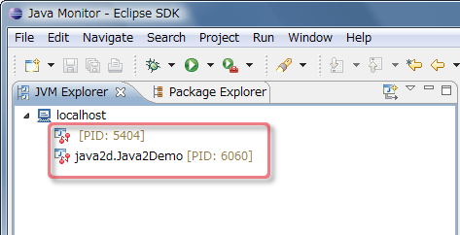
JVM Monitor

Slide 90
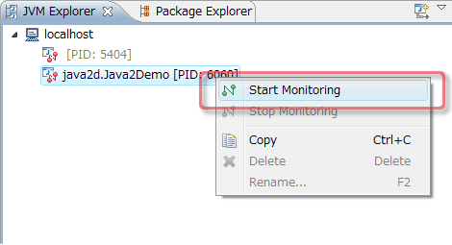
JVM Monitor

Slide 91
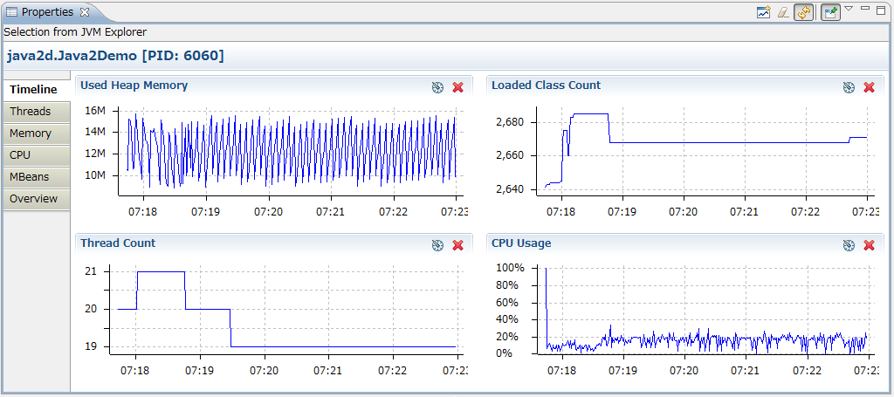
JVM Monitor

Slide 92
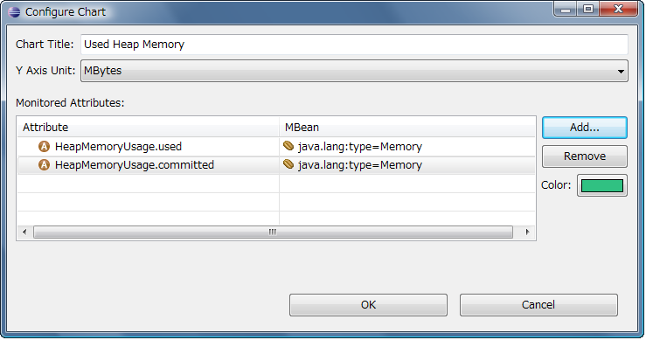
JVM Monitor

Slide 93
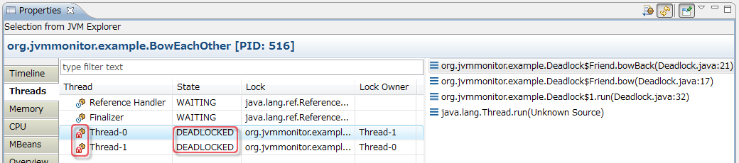
JVM Monitor

Slide 94
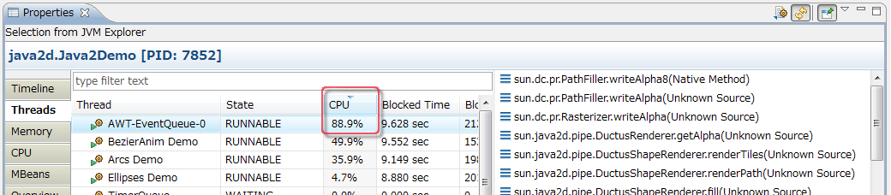
JVM Monitor

Slide 95
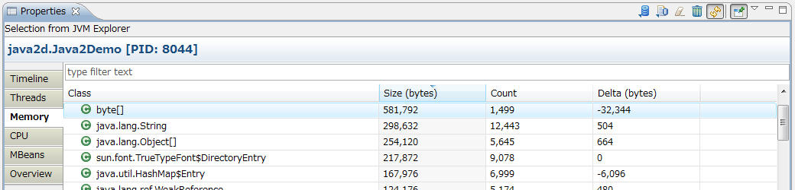
JVM Monitor

Slide 96
Better Optimizing Compilers
For example, the JAVAR compiler (http://www.extreme.indiana.edu/hpjava/) is a prototype compiler.
It automatically parallelizes parts of a Java application to improve performance.

Slide 97
What Optimizing Compilers Cannot Do
Optimizing compilers cannot change your code to use a better algorithm .
If you are using an inefficient search routine, there may be hugely better search algorithms giving orders of magnitude speedups.
But the optimizing compiler only tries to speed up the algorithm you are using (with a probable small incremental speedup).
It is still important to profile applications to identify bottlenecks even if you intend to use an optimizing compiler.

Slide 98
What Optimizing Compilers Cannot Do
Optimizing compilers have difficulty dealing with classes that cannot be identified at compile time (e.g., building a string at runtime and loading a class of that name).
Basically, using Class.forName( ) is not (and cannot be) handled in any complete way, though several compilers try to manage as best they can.

Slide 99
What Optimizing Compilers Can Do
Remove unused methods and classes (This can include removing superclass methods that have been overridden in a subclass and are never called in the superclass)
Increase statically bound calls(the method invocation can be compiled as a static invocation,which is faster than a dynamic lookup)
Cut dead code and unnecessary instructions, including checks for null
Use computationally cheaper alternatives (strength reduction)
x = x + 5;
y = x/2;
z = x * 4;
These lines can be replaced by faster operations without altering the meaning of any statements:
x += 5; //Assignment in place is faster
y = x >> 1; //each right shift by one place is equivalent to dividing by 2
z = x << 2; //each left shift by one place is equivalent to multiplying by 2

Slide 100
What Optimizing Compilers Can Do
Remove unused methods and classes (This can include removing superclass methods that have been overridden in a subclass and are never called in the superclass)
Increase statically bound calls(the method invocation can be compiled as a static invocation,which is faster than a dynamic lookup)
Cut dead code and unnecessary instructions, including checks for null
Use computationally cheaper alternatives (strength reduction)
x = x + 5;
y = x/2;
z = x * 4;
These lines can be replaced by faster operations without altering the meaning of any statements:
x += 5; //Assignment in place is faster
y = x >> 1; //each right shift by one place is equivalent to dividing by 2
z = x << 2; //each left shift by one place is equivalent to multiplying by 2

Slide 101
What Optimizing Compilers Can Do
All the shorthand arithmetic operators (++, --, +=, -=, *=, /=, |=, &=) are computationally faster than their nonshorthand expansions.
It should be used (by the coder) or replaced (by the compiler) where appropriate
Replace runtime computations with compiled results
String S_NINETY = "90";
int I_NINETY = Integer.parseInt(S_NINETY);
If optimization compiler knows conversion at compile time, run time compilation can be avoided.

Slide 102
What Optimizing Compilers Can Do
Remove unnecessary parts of compiled files
This option removes line number tables and local variable tables.
The Java .class file structure allows extra information to be inserted.
Some optimizing compilers make an effort to remove everything that is not necessary for runtime execution.
Reduce necessary parts of compiled files
For example, the .class file includes a pool of constants (a structure containing various constants).
An optimizing compiler can minimize the size of the constant pool by combining and reducing entries.

Slide 103
What Optimizing Compilers Can Do
Alter access control to speed up invocations
The rationale for this is that any non-public method has access control on that method since it is access restricted,
The runtime system must verify at some point that the caller to a method has access to calling that method.
Inline calls
private int method1( ) { return method2( ); }
private int method2( ) { return 5; }
With inlining operating to optimize method1( ), this code is compiled into the equivalent of:
//the call to method2( ) is replaced with the code in method2( )
private int method1( ) { return 5; }
private int method2( ) { return 5; }

Slide 104
What Optimizing Compilers Can Do
Remove dynamic type checks
Integer i = new Integer(3);
Integer j = (Integer) i;
The JDK compiler removes the obviously unnecessary cast here, and the code gets compiled as if the source was:
Integer i = new Integer(3);
Integer j = i;

Slide 105
What Optimizing Compilers Can Do
Unroll loops
Loop unrolling makes the loop body larger by explicitly repeating the body statements while changing the amount by which the loop variable increases or decreases.
This reduces the number of tests and iterations the loop requires to be completed.

Slide 106
What Optimizing Compilers Can Do
Code motion
for (int i = 0; i < z.length; i++)
z[i] = x * Maths.abs(y);
int t1 = x * Maths.abs(y);
for (int i = 0; i < z.length; i++)
z[i] = t1;

Slide 107
What Optimizing Compilers Can Do
public String aMethod(String first, String passed)
{
StringBuffer copy = new StringBuffer(passed);
if (first == null || first.length( ) == 0)
return passed;
else
{
...//some manipulation of the string buffer to do something
return copy.toString( );
}
}

Slide 108
What Optimizing Compilers Can Do
public String aMethod(String first, String passed)
{
if (first == null || first.length( ) == 0)
return passed;
else
{
StringBuffer copy = new StringBuffer(passed);
...//some manipulation of the string buffer to do something
return copy.toString( );
}
}

Slide 109
What Optimizing Compilers Can Do
Eliminate common subexpressions
z1 = x * Maths.abs(y) + x;
z2 = x * Maths.abs(y) + y;
int t1 = x * Maths.abs(y);
z1 = t1 + x;
z2 = t1 + y;

Slide 110
What Optimizing Compilers Can Do
Eliminate unnecessary assignments
int x = 1;
x = 2;
int x = 2;

Slide 111
What Optimizing Compilers Can Do
Rename classes, fields, and methods
Some compilers rename classes, fields, and methods for various reasons, such as for obfuscating the code (making the code difficult to understand if it were decompiled).

Slide 112
What Optimizing Compilers Can Do
Reorder or change bytecodes
An example is where a switch statement is used with a list of unordered, nearly consecutive values for case statements.
An optimizing compiler can reorder the case statements so that the values are in order, insert extra cases to make the values fully consecutive, and then use a faster switch bytecode to execute the switch statement.

Slide 113
What Optimizing Compilers Can Do
Generate information to help a VM
A more extreme example might be where a compiler generates optimized native code for several CPUs in addition to the bytecode for methods in the class file.
This would allow a VM to execute the native code immediately if it were running on one of the supported CPUs.
Unfortunately, this particular example would cause a security loophole, as there would be no guarantee to the VM that the natively compiled method was the equivalent of the bytecode-generated one.

Slide 114
What Optimizing Compilers Can Do
Literal constants are folded
int foo = 9*10;
int foo = 90;

Slide 115
What Optimizing Compilers Can Do
String concatenation is sometimes folded
String foo = "hi Joe " + (9*10);
is compiled as if it read:
String foo = "hi Joe 90";

Slide 116
What Optimizing Compilers Can Do
Constant fields are inlined
For instance, if class A is defined as:
public class A
{
public static final int VALUE = 33;
}
and class B is defined as:
public class B
{
static int VALUE2 = A.VALUE;
}

Slide 117
What Optimizing Compilers Can Do
Constant fields are inlined
public class B
{
static int VALUE2 = 33;
}
with no reference left to class A.

Slide 118
What Optimizing Compilers Can Do
Dead code branches are eliminated
public class A
{
public static final boolean DEBUG = false;
}
public class B
{
static int foo( )
{
if (A.DEBUG)
System.out.println("In B.foo( )");
return 55;
}
}

Slide 119
What Optimizing Compilers Can Do
Dead code branches are eliminated
public class B
{
static int foo( )
{
return 55;
}
}

Slide 120
Going through a slow response time umbrella
Client side
HTTP server side (web servers)
Application server issue
Database server issue
Integrated systems
Networking components
Code and script analysis
Profiling the application

Slide 121
Common performance issues
Threading performance issues
Threading performance issues are the issues related to concurrency, as follows:
Lack of threading or excessive threading
Threads blocking up to starvation (usually from competing on shared resources)
Deadlock until the complete application hangs (threads waiting for each other)

Slide 122
Common performance issues
Memory performance issues
Memory performance issues are the issues that are related to application memory
management, as follows:
Memory leakage: This issue is an explicit leakage or implicit leakage as seen in
improper hashing
Improper caching: This issue is due to over caching, inadequate size of the object,
or missing essential caching
Insufficient memory allocation: This issue is due to missing JVM memory tuning

Slide 123
Common performance issues
Algorithmic performance issues
Implementing the application logic requires two important parameters that are related to each other; correctness and optimization.
If the logic is not optimized, we have algorithmic issues, as follows:
Costive algorithmic logic
Unnecessary logic

Slide 124
Common performance issues
Work as designed performance issues
Using synchronous when asynchronous should be used
Neglecting remoteness, that is, using remote calls as if they are local calls
Improper loading technique, that is, eager versus lazy loading techniques
Selection of the size of the object
Excessive serialization layers
Web services granularity
Too much synchronization
Non-scalable architecture, especially in the integration layer or middleware
Saturated hardware on a shared infrastructure

Slide 125
Common performance issues
Interfacing performance issues
Whenever the application is dealing with resources, we may face the following interfacing
issues that could impact our application performance:
Using an old driver/library
Missing frequent database housekeeping
Database issues, such as, missing database indexes
Low performing JMS or integration service bus
Logging issues (excessive logging or not following the best practices while logging)
Network component issues, that is, load balancer, proxy, firewall, and so on

Slide 126
Common performance issues
Miscellaneous performance issues
Miscellaneous performance issues include different performance issues, as follows:
Inconsistent performance of application components, for example, having slow
components can cause the whole application to slow down
Introduced performance issues to delay the processing speed
Improper configuration tuning of different components, for example, JVM,
application server, and so on
Application-specific performance issues, such as excessive validations, apply many
business rules, and so on

Slide 127
Common performance issues
Fake performance issues
Fake performance issues could be a temporary issue or not even an issue. The famous
examples are as follows:
Networking temporary issues
Scheduled running jobs (detected from the associated pattern)
Software automatic updates (it must be disabled in production)
Non-reproducible issues

Slide 128
Common performance issues
Database performance issues
Using an old database version
Using an old JDBC driver library
Missing table indexes in frequently used tables (SQL tuning principals)
ORM layer tuning (such as JPA caching and index preallocation)
Missing batch or bulk database operations in massive database manipulations
Missing regular database housekeeping
Housekeeping includes the following examples:
Having frequent backups
Partitioning the large tables
Cleaning the different table spaces, for example, temporary and undo table space
Archiving the old records

Slide 129
Common performance issues

Slide 130
Client-side performance issues
Performance issues on the client side means either a JavaScript coding issue or slow
loading of different resources.
Rarely do we need to consider cascading style sheets(CSS).
The initial set of questions that we need to answer when we face client-side performance issue is as follows:
Is the issue related to the browser type?
Is it related to the page size or resources size?
What happens if we disable JavaScript in the browser?
Did this issue occur in the performance testing tool?

Slide 131
Object Creation
The biggest difference between time and space is that you can't reuse time.
----Merrick Furst
Avoid creating objects in frequently used routines
Try to presize any collection object to be as big as it will need to be.
For example, Vector grows by creating a new larger internal array object, copying all the elements from and discarding the old array.
Most collection implementations have similar implementations for growing the collection beyond its current capacity, so presizing a collection to its largest potential size reduces the number of objects discarded.

Slide 132
Object Creation
When multiple instances of a class need access to a particular object in a variable local to those instances, it is better to make that variable a static variable rather than have each instance hold a separate reference.
Reuse exception instances when you do not specifically require a stack trace

Slide 133
Uncompressed ZIP/JAR Files
It is better to deliver your classes in a ZIP or JAR file than to deliver them one class at a time over the network or load them individually from separate files in the filesystem.
The benefits gained from packaging class files come from reducing I/O overheads such as repeated file opening and closing and possibly improving seek times

Slide 134
Object Creation
It is better to deliver your classes in a ZIP or JAR file than to deliver them one class at a time over the network or load them individually from separate files in the filesystem.
The benefits gained from packaging class files come from reducing I/O overheads such as repeated file opening and closing and possibly improving seek times

Slide 135
Excess Object Creation
Example : A Person object that holds a Name object, consisting of first name
and last name and an Address object, with street, number, etc.
These three objects can be collapsed down to just the Person object, with all the
fields moved up to the Person class
continue….

Slide 136
Excess Object Creation
public class Person
{
private Name name;
private Address address;
}
class Name
{
private String firstName;
private String lastName;
private String[] otherNames;
}
class Address
{
private int house Number;
private String houseName;
private String streetName;
private String town;
private String area;
private String greater Area;
private String country;
private String postCode;
}

Slide 137
Excess Object Creation
These three classes collapse into one class:
public class Person
{
private String firstName;
private String lastName;
private String[] otherNames;
private int houseNumber;
private String houseName;
private String streetName;
private String town;
private String area;
private String greaterArea;
private String country;
private String postCode;
}

Slide 138
Reuse Object
Objects are expensive to create so it is reasonable to reuse the same object.
• This requires awareness of when not to create new object.
• Look at the object and consider whether it is possible to reset the fields and then
reuse the object, rather than throw it away and create another
• Important for objects that are constantly used and discarded: for example, in
graphics processing, objects such as Rectangles, Points, Colors, and Fonts are
used and discarded all the time. Recycling these types of objects can certainly
improve performance.

Slide 139
Manage Pool Of Objects
While not using the retained objects, we are holding on to more memory than if
we simply discarded those objects, and this reduces the memory available to
create other objects .
• Balance the need to have some free memory available against the need to
improve performance by reusing objects.
• The space taken by retaining objects for later reuse is significant only for very
large collections, and you should certainly know which ones these are in your
application.

Slide 140
Canonicalizing Objects
This activity of replacing multiple copies of an object with just a few
objects is often referred to as canonicalizing objects.
Example:
Boolean t1 = new Boolean(true);
System.out.println(t1=!Boolean.TRUE);
System.out.println(t1.==(Boolean.TRUE));
produces the output:
false
true

Slide 141
Enumerating constants
Another canonicalization technique often used is replacing constant objects with integers this is called Enumeration.
Enumeration can provide both speed and memory advantages.
The enumeration requires less memory than the equivalent strings and makes network transfers faster.
Example: public interface GENDER
{
public static final int FEMALE=1;
public static final int MALE=2;
}
Rather than use the strings "female" and "male", you should use a
constant defined in an interface

Slide 142
Comparison verses Identity
Comparisons are faster compared to identity
• Comparison can be used instead of the equality comparison.
Example:
you can use
this.gender == FEMALE;
instead of:
this.gender.equals("Female");

Slide 143
Avoid Excess Garbage Collection
The canonicalization techniques are one way to avoid garbage collection fewer
objects means less to garbage-collect.
• The pooling technique tends to reduce garbage-collection requirements, partly
because you are creating fewer objects by reusing them, and partly because you
deallocate memory less often by holding on to the objects you have allocated
• Reducing garbage collection by using primitive data type . Hold an object in a
primitive data-type format rather than another format as primitive data type use
less memory.

Slide 144
Lazy Initialization
Technique of delaying object creation until the last possible moment.
This technique is useful for avoiding unnecessary object creation when only a few objects are used although many possible objects can be created.
Many objects that need to be created and initialized, and most of these objects will be used, but not immediately.
In this case, it can be useful to spread out the load of object initialization so you don't get one large hit on the application.
It may be better to let a background thread initialize all the objects slowly or to use lazy initialization to take many small or negligible hits, thus spreading the load over time.

Slide 145
Profiling Tools

Slide 146
CPU Performance
This tool have CPU snapshot contains the following tabs:
• Call Tree Displays the Calling Context Tree (CCT) showing the method
call chain and the time/number of invocations for executing threads and
methods in each context. (A context is a unique chain of method calls
leading to the method's invocation.)
• Hot Spots Shows the total execution time and number of invocations for
each method, irrespective of the context.

Slide 147
Java Performance Tuning Tools

Slide 148
Memory Usage
This tools have snapshots contains the following tab:
• Allocated Objects: The number of objects that the NetBeans Profiler is
actually monitoring.
• Live Objects: The number of the Allocated Objects that are still on the JVM's
heap and are therefore taking up memory.
• Live Bytes: The two columns show the amount of heap memory being used by
the Live Objects. One column displays a graph, the other displays text.
• Avg. Age: This value is calculated using the Live Objects. The age of each
object is the number of garbage collections that it has survived. The sum of the
ages divided by the number of Live Objects is the Avg. Age.

Slide 149
Resolving memory leaks
Start your application inside the memory profiler
Execute your use-case (make the request) once to allow the application to load all of the objects that it needs in memory to satisfy the request; this reduces the amount of noise that you have to sift through later
Take a snapshot of the heap to capture all objects in the heap before the use-case has been executed
Execute your use-case again
Take another snapshot of the heap to capture all objects in the heap after the use-case has been executed
Compare the two snapshots and look for objects that should not remain in the heap after executing the use-case

Slide 150
Memory Usage

Slide 151
Memory Usage

Slide 152
Developing High Performance Java Applications - Checklist
Reduce the number of temporary objects being used, especially in loops.
• Avoid creating temporary objects within frequently called methods.
• Presize collection objects.
• Reuse objects where possible.
• Empty collection objects before reusing them. (Do not shrink them unless they are very large.)
• Use custom conversion methods for converting between data types (especially strings and streams) to reduce the number of temporary objects.
• Define methods that accept reusable objects to be filled in with data, rather than methods that return objects holding that data. (Or you can return immutable objects.)

Slide 153
Developing High Performance Java Applications - Checklist
Canonicalize objects wherever possible. Compare canonicalized objects by identity.
• Use primitive data types instead of objects as instance variables.
• Preallocate storage for large collections of objects by mapping the instance variables into multiple arrays.
• Eliminate object-creation bottlenecks by moving object creation to an alternative time.
• Create objects early, when there is spare time in the application, and hold those objects until required.
• Use lazy initialization when there are objects or variables that may never be used, or when you need to distribute the load of creating objects.

Slide 154
Java 6 Performance Improvements
Runtime performance optimizations
Biased locking
Lock coarsening
Adaptive spinning
Support for large page heap on x86 and amd64 platforms
Array Copy Performance Improvements
Background Compilation in HotSpot™ Client Compiler
New Linear Scan Register Allocation Algorithm for the HotSpot™ Client Compiler

Slide 155
Java 6 Performance Improvements
Garbage Collection Biased locking
Parallel Compaction Collector
Concurrent Low Pause Collector: Concurrent Mark Sweep Collector Enhancements
Ergonomics in the 6.0 Java Virtual Machine
Client-side Performance Features and Improvements
New class list for Class Data Sharing
Improvements to the boot class loader
Splash Screen Functionality
Swing's true double buffering
Improving rendering on windows systems

Slide 156
Why is Tuning important?

Slide 157
What's new in Java 1.7?
Strings in switch
Multi-Exception Catch
Underscores in numeric literals(Removing eye strains)
Binary literals
Improved Type Inference for Generic Instance Creation (Diamond Operator)
Try with Resources (Automatic resource management)
Var args Warnings –Erasure
Java NIO.2 –File Navigation Helpers
Language support for Collections(proposal submitted)
Null Safe(proposal submitted)
Java 7

Slide 158
Java 7 Performance Improvements
Provide JVM support for dynamic languages, following the prototyping work currently done on the Multi Language Virtual Machine
Enhance the existing concurrency library by managing parallel computing on multi-core processors
Allow the virtual machine to use both the Client and Server compilers in the same session with a technique called tiered compilation
The Client would be used at startup (because it is good at startup and for small applications),
The Server would be used for long-term running of the application (because it outperforms the Client compiler for this).

Slide 159
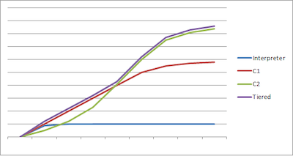
Java 7 Performance Improvements

Slide 160
C0 compilation
C0 – a mythical bytecode-straight-to-asm dumb translator.
Typically used instead of an Interpreter.
HotSpot uses an Interpreter and so does Azul’s VM (and so we do not have a C0).
Our Interpreter is structured different from the HotSpot norm in a bunch of interesting ways (but that’s for another blog).

Slide 161
C1 compilation
C1 – also known as the client compiler.
A fast & dumb compiler.
You get this compiler from a normal HotSpot with the “-client” flag.
Code quality suffers in exchange for faster compile times.
This makes for a quicker startup times in exchange for lower peak throughput.
The client compiler typically uses less memory to compile than the server compiler, and typically makes bulkier code per-line-of-Java compiled…
BUT: it also typically inlines much less aggressively than server compiler and so does not replicate so much code. Code frames are typically fairly large. Performance is typically roughly 5x to 10x the interpreter speed.

Slide 162
C2 Compilation
C2 – also known as the server compiler.
A slow & smart compiler, with opposite tradeoffs from C1: slower compiles, slower startup, better code quality, higher peak throughput (after the slow compiles).
C2 typically uses more memory to compile, makes much denser code – but inlines much more aggressively (so ends up compiling a lot more lines of Java code).
Code frames are typically very dense (C2 uses a graph-coloring allocator even for stack frames).
Performance is roughly 30% (on X86) to 50% (on RISCs like Sparc & Azuls’ Vega chips) better than C1.
Mileage varies of course, according to which benchmark and which rev of which compiler is being used.

Slide 163
Tiered compilation
Tiered compilation in hotspot is an old dream.
Hotspot has two JITs named c1 aka client JIT and c2 aka server JIT.
The client JIT starts fast but provides less optimizations so it is used for GUI application.
The server JIT starts more slowly but provide very good optimizations.
The idea of tiered compilation is to get the best of both compilers, first JITs the code with c1 and then if the code is really hot to recompile it with c2.

Slide 164
Tiered compilation
BOTH compilers are used; C1 for fast startup and C2 for peak performance.
Obtained on Azul’s VMs with any of the “-tiered”, “-client” or “-server” flags, and also is the default.
(We made the “-client” and “-server” flags turn on Tiered compilation because so many customers have either flag baked into their launch scripts, which would immediately deny the benefit of tiered compilation. We use other flags for turning off either compiler).

Slide 165
Java 7 Performance Improvements
Replace the existing concurrent low-pause garbage collector (also called CMS or Concurrent Mark-Sweep collector) by a new collector called G1 (or Garbage First) to ensure consistent pauses over time.

Slide 166
Performance Tuning Guidelines for J2EE Applications

Slide 167
General Performance Guidelines
Servlets and Java Server Pages
Avoid using shared modified class variables and hence, synchronized blocks of code in servlets
Session creation is expensive
Invalidate sessions no longer needed
Use <%page session=false%> directive to prevent automatic session creation in JSP
Do not store large object graphs in HttpSession to avoid forced Java serialization.
Do not use HttpSession as a cache for transactional data, instead use “read-
only” entity beans, if provided by your container, to access cached
transactional data

Slide 168
What is JMeter?
The protocols supported by JMeter are:
Web: HTTP, HTTPS sites 'web 1.0' web 2.0 (ajax, flex and flex-ws-amf)
Web Services: SOAP / XML-RPC
Database via JDBC drivers
Directory: LDAP
Messaging Oriented service via JMS
Service: POP3, IMAP, SMTP
FTP Service

Slide 169
Features of JMeter?
Its free. Its an open source software.
It has simple and intuitive GUI.
JMeter can load and performance test many different server types: Web - HTTP, HTTPS, SOAP, Database via JDBC, LDAP, JMS, Mail - POP3
It is platform-independent tool.
On Linux/Unix, JMeter can be invoked by clicking on JMeter shell script.
On Windows it can be invoked by starting the jmeter.bat file.

Slide 170
Features of JMeter?
It has full Swing and lightweight component support (precompiled JAR uses packages javax.swing.* ).
JMeter store its test plans in XML format.
This means you can generate a test plan using a text editor.
It's full multi-threading framework allows concurrent sampling by many threads and simultaneous sampling of different functions by separate thread groups.
It is highly Extensible.
Can also be used to perform automated and functional testing of your application.

Slide 171
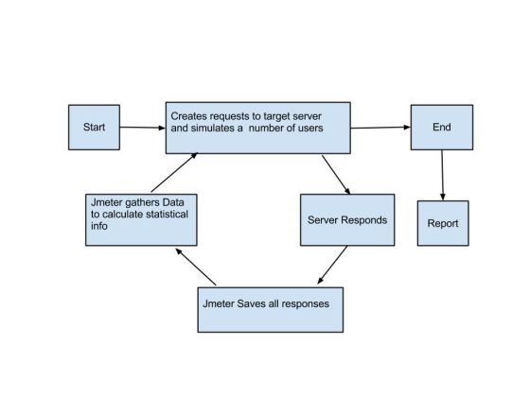
How Jmeter Works

Slide 172
Performance Tuning of Servlet and JSP
HttpServlet init() method
Servlet & JSP auto-reloading
Controlling HttpSession
gzip compression
SingleThreadModel
Thread pool
Include mechanism
useBean action
Miscellaneous techniques

Slide 173
Technique 1: [HttpServlet init() method]
Every Servlet contains init() method which is called only once in lifetime.
Web Container invoke init() method after creating Servlet instance and before handling any client request.
We can use init() method to improve performance by caching the static data and/or completing the expensive operations that need to be performed only during initialization.

Slide 174
Technique 1: [HttpServlet init() method]
It is a best practice to use JDBC (Java Database Connectivity) connection pooling for database operation.
We get the DataSource from the JNDI (Java Naming and Directory Interface) tree.
Performing the JNDI lookup for DataSource for every SQL call is expensive and
severely affects an application's performance.
We should use Servlet's init() method to get DataSource and cache it for later reuse:

Slide 175
Technique 1: [HttpServlet init() method]
public class ControllerServlet extends HttpServlet
{
private javax.sql.DataSource ds = null;
public void init(ServletConfig config) throws ServletException
{
super.init(config);
Context ctx = null;
try
{
ctx = new InitialContext();
ds = (javax.sql.DataSource)ctx.lookup("jdbc/hr");
}
catch(NamingException ne)
{

Slide 176
Technique 1: [HttpServlet init() method]
ne.printStackTrace();
}
catch(Exception e)
{
e.printStackTrace();
}
}
public javax.sql.DataSource getDS()
{
return ds;
}
...
...
}

Slide 177
Technique 2: [Servlet and JSP auto-reloading]
Servlet/JSP auto-reloading is useful during the development phase because it reduces development time, generally we do not have to restart the server after every change in the servlet/JSP.
However, it is expensive in the production phase; servlet/JSP auto-reloading gives poor performance because of unnecessary loading and burdening on the classloader.
Also, it may put your application in strange conflicts when classes loaded by a certain classloader cannot cooperate with classes loaded by the current classloader.
So turn off auto-reloading for servlet/JSP in a production environment to receive better performance.

Slide 178
Technique 3: [Controling HttpSession]
Do not create HttpSession in JSP pages by default:
By default, JSP pages create HttpSession.
If we do not use HttpSession in your JSP pages, disable session by following
page directive tag, it will save some performance overhead.
<%@ page session="false"%>
b) Do not store large object graphs inside an HttpSession
C) Release HttpSessions when done:
d) Set session time-out value

Slide 179
Technique 4: [gzip compression]
Using gzip (GNU zip) to compress the document can dramatically reduce download
times for HTML files.
The smaller our information's size, the faster it can all be sent.

Slide 180
Technique 4: [gzip compression]
String encoding = request.getHeader("Accept-Encoding");
if (encoding != null && encoding.indexOf("gzip") != -1)
{
response.setHeader("Content-Encoding" , "gzip");
out = new GZIPOutputStream(response.getOutputStream());
}
else if (encoding != null && encoding.indexOf("compress") != -1)
{
response.setHeader("Content-Encoding" , "compress");
out = new ZIPOutputStream(response.getOutputStream());
}
else
{
out = response.getOutputStream();
}

Slide 181
Technique 5: [SingleThreadModel]
SingleThreadModel ensures that servlets handle only one request at a time.
If a servlet implements this interface, the servlet engine will create separate servlet instances for each new request, which will cause a great amount of system overhead
SingleThreadModel interface is deprecated in Servlet 2.4.

Slide 182
Technique 6: [Include mechanism]
There are two ways you can include files in a JSP page:
include directive (<%@ include file="test.jsp" %>) and include action (<jsp:include page="test.jsp" flush="true" />).
The include directive includes the specified file's content during the translation phase; i.e., when the page converts to a servlet.
The include action includes the file's content during the request processing phase; i.e., when a user requests the page.
Include directive is faster than include action.
So unless the included file changes often, use include directive for better performance.

Slide 183
Technique 7: [useBean action scope]
One of the most powerful ways to use JSP pages is in cooperation with a JavaBeans component.
JavaBeans can be directly embedded in a JSP page using the <jsp:useBean> action tag. The
syntax is as follows:
<jsp:useBean id="name" scope="page|request|session|application" class=
"package.className" type="typeName">
</jsp:useBean>

Slide 184
Technique 7: [useBean action scope]
The scope attribute specifies the scope of the bean's visibility.
The default value for scope attribute is page.
You should select the correct scope based on your application's requirements; otherwise it will affect application performance.

Slide 185
Technique 8: [Miscellaneous]
Avoid string concatenation
Avoid the use of System.out.println
ServletOutputStream versus PrintWriter: Using PrintWriter involves small overhead because
it is meant for character output stream and encodes data to bytes.
So PrintWriter should be used to ensure all character-set conversions are done correctly.
On the other hand, use ServletOutputStream when you know that your servlet returns only binary data, thus you can eliminate the character-set conversion overhead as the servlet container does not encode the binary data.

Slide 186
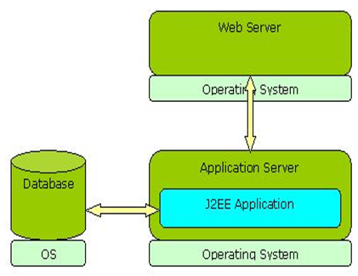
Need for J2EE Performance Tuning
For maximum performance, all the components such as operating system, web server and application server need to be optimized.
The obvious way to improve the performance of an application is by scaling up the hardware.
But hardware scaling may not work in all scenarios and is certainly not the best cost effective method. Tuning can improve the performance without extra costs for the hardware.
In order to obtain the best J2EE application performance, all the underlying layers should be properly tuned.

Slide 187
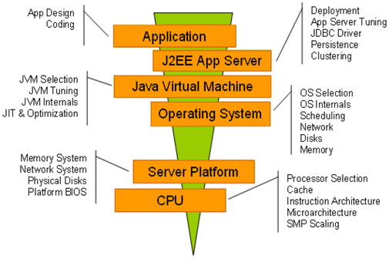
Typical Approach for Tuning Performance

Slide 188
Performance optimization considerations
Performance optimization considerations are distributed across various levels of the top-down stack:
System level: Performance barriers such as input/output (I/O), operating system and database bottlenecks.
Application level: Application design considerations and application server tuning.
Machine level: Hardware level performance considerations and JVM implementations such as processor frequency, cache sizes, and multi-processor scaling.

Slide 189
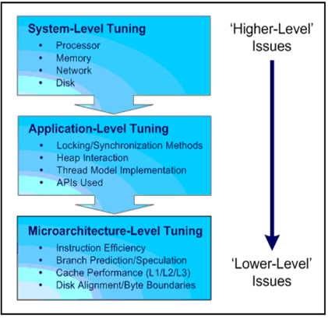
Performance optimization considerations

Slide 190
Application Layer Tuning
Proper garbage collection
You are supposed to reuse the existing objects.
Creation of unnecessary objects should be avoided.
You need to avoid explicit garbage collection i.e. avoid calling System.gc().
Use static methods whenever there is a scope

Slide 191
Application Layer Tuning
Using correct parser
SAX programs are much faster than their DOM equivalents and almost use less memory.
SAX can be used only for a sequential processing of an XML file whereas DOM can be used for random processing of XML files.
For parsing large XML files, it is a good idea to go for SAX parser.

Slide 192
Application Layer Tuning
Data caching
Cache objects in frequently used methods so that they will persist between calls. Make sure that the cached object’s state is set properly before subsequent use.
You can utilize browser caching.

Slide 193
Application Layer Tuning
Optimized coding
Writing an intelligent and optimized Java code is one of the most important aspects of performance tuning.
You can always change the storage location of data based on the frequency of access.
Import selectively and reuse existing code.
Write modular code and promote loose coupling.
Try to use mutable objects. Know when to use immutable objects as they consume memory.
Do not create unnecessary threads and temporary variables.
Avoid excessive writing to the Java console. It’s not a good idea and it degrades the performance.

Slide 194
Application Layer Tuning
Using Data Types
Primitive types are faster than classes encapsulating the types.
It is better to avoid the costs of creating and manipulating the objects by utilizing primitive variable types when prudent.
Memory could be minimized and the access time of variables could be enhanced accordingly.
You must use ‘int’ whenever appropriate on 32-bit systems (‘long’ is 64-bit data type).

Slide 195
Application Layer Tuning
Using Data Types
Casting in Java is not done at compile time. So avoid unnecessary recasting of variables.
Use static final keyword while creating constants. You can declare the data as static and final when it is invariant.
If possible, declare methods as final. Validate all input data at client side.
Static include is always faster than dynamic include.
Try to minimize the data stored in HTTP session.
Disable the session creation in JSP if not required.

Slide 196
Application Layer Tuning
Efficient Data Storage
You may compress and decompress the serialized objects and save disk space.
This can be done on the fly to improve the performance of client-server applications (zipping and unzipping the data).
Try to encode and decode the data by using different classes such as base32 and base64 classes.

Slide 197
Database Layer Tuning
Whenever you are using select query, try to mention only the required columns.
You can just use the columns that you wish to fetch and this will improve the performance.
You can always optimize your query by using appropriate tools.
Try to use prepared statements as they are precompiled.
Whenever you create any statement object or a connection object in your DAO layer, it would be better to close or flush them in a finally block.
Try to minimize the number of JDBC calls. You can achieve this by using JDBC connection pool or various design patterns such as singleton pattern.

Slide 198
Database Layer Tuning
Database Server Tuning
Create index over the table whenever it is required.
Whenever your select query involves more than 6 tables, try to denormalize the table.
To improve the performance, you need to reduce the number of tables.
In case of batch operations, it is not a good idea to create SQL queries.
SQL query will be compiled every time and then it is executed.
You can use stored procedures. Stored procedures are compiled only once when they are executed for the first time.
Avoid using views unless it is really needed. Querying from view takes more time than directly querying from the table.

Slide 199
Application Server Tuning
Here you need to know where to tune and also the extent of tuning.
Increase the JVM size of the application server.
For instance, in Weblogic Admin server, the size of the JVM can be extended by altering the values of Xmx and Xms in setDomainEnv.sh shell script.
Session attributes must implement java.io.Serializable interface.
Make your applications distributable.
Group all related search queries in a single JDBC call.
The basic idea of performance tuning in DAO layer is to reduce the number of JDBC calls.
Optimize the methods that are used most often.
Reduce the complexity of J2EE application. For example, try to separate the controller logic from the business logic.

Slide 200
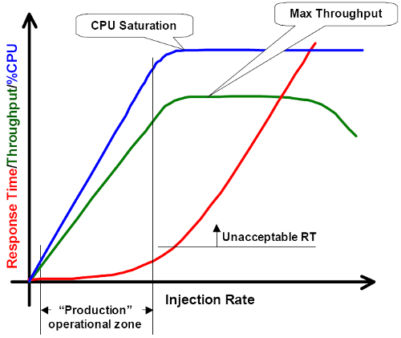
When Can You Conclude Performance Tuning?

Slide 201
The two dimensions of web applications’ performance tuning
Horizontal Dimension ( Node to Node)
Vertical Dimension (intranode)

Slide 202
Horizontal Dimension

Slide 203
http://www.appperfect.com/support/java-coding-rules/optimization.html#rule1

